Slide 1
Part I: Conjoint Analysis for Measuring Consumer Preference
Dr. Upender Subramanian
MKT/BUAN 6337

Slide 2
Basic Idea
When designing a new product or introducing multiple versions of the same product, manager needs to decide what features to include and how to price
Conducting a study for every possible feature, price and version combination can be impractical
Instead, develop a model of consumer preferences (utility) based on product features and price
Estimate the model based on a subset of possible combinations of features and price
Use the model to predict outcome for different feature, price and versions that the manager can introduce

Slide 3
Conjoint Analysis
Conjoint: Technique for finding consumer preferences based on their ratings, rankings or choices of alternatives
Stated vs. Revealed Preferences
Stated: Simply ask consumers how much they are willing to pay for different features and brands
Revealed: Observe consumer behaviors and infer their preference
Stating preferences and making tradeoffs explicitly can be an artificial task for consumers – can lead to biases
Revealed preferences is more reliable for predicting actual behavior

Slide 4
Types of Conjoint Studies
Ratings-based conjoint: Consumers has to rate each alternative (e.g., on a scale of 1 – 100), OR allot 100 points between handful of alternatives
Ranking-based conjoint: Consumers rank the alternatives in the order of preference
Choice-based conjoint: Consumers choose their best alternative
Incentivized conjoint: Participants are given a chance to win one of the products that they choose
So they have incentive to choose products that they truly like
More difficult to incentivize ratings or ranking based conjoint

Slide 5
Ratings vs. Rankings vs. Choice
Tradeoff is between what type of data is easier to analyze, and what type of decision task is most realistic, easiest for consumers
Ratings: least realistic, historically easiest to analyze
Choice: most realistic, now also easy to analyze
Also more data is available for ratings / rankings, as consumers rate / rank all alternatives

Slide 6
Conjoint Analysis: Theory
Consumers view a product as a bundle of attributes (incl. brand name and price)
Each level of an attribute provides some “utility”
Total utility from product is sum of utility from each attribute
Phone Cover Example
“utils” = units of measuring utility, only relative magnitude matters
Color: Yellow = 3 utils, Blue = 5 utils, Red = 10 utils
Price: $1 = 1 utils, $2 = 0 utils, $3 = -2 utils
Yellow Cover at $1 = 3 + 1 = 4 utils
Red Cover at $3 = 10 – 2 = 8 utils
Consumers choose the product that provides highest utility

Slide 7
Example: Chocolate Study
Study Objective: Understand how consumers value the following attributes of chocolate
Dark vs. Milk
Soft vs. Chewy
Nuts vs. Non Nuts
Study design
8 varieties of chocolate from 2 x 2 x 2 combination of attributes
Participants shown descriptions of all varieties and asked to choose one (Full profile conjoint)
Data collected for 10 participants

Slide 8
Example: Chocolate Study
Attributes
Participant | Dark | Soft | Nuts | Chosen
1 | 0 | 0 | 0 | 2
1 | 0 | 0 | 1 | 2
1 | 0 | 1 | 0 | 2
1 | 0 | 1 | 1 | 2
1 | 1 | 0 | 0 | 1
1 | 1 | 0 | 1 | 2
1 | 1 | 1 | 0 | 2
1 | 1 | 1 | 1 | 2
2 | 0 | 0 | 0 | 2
2 | 0 | 0 | 1 | 2
2 | 0 | 1 | 0 | 2
2 | 0 | 1 | 1 | 2
2 | 1 | 0 | 0 | 2
2 | 1 | 0 | 1 | 1
2 | 1 | 1 | 0 | 2
2 | 1 | 1 | 1 | 2
8 Combinations shown to Participant 1
Participant 1’s Choice
(1 = Chosen,
2 = Not Chosen)
8 Combinations shown to Participant 2
Participant 2’s Choice
.
.
.
.
.
.
.
.
.

Slide 9
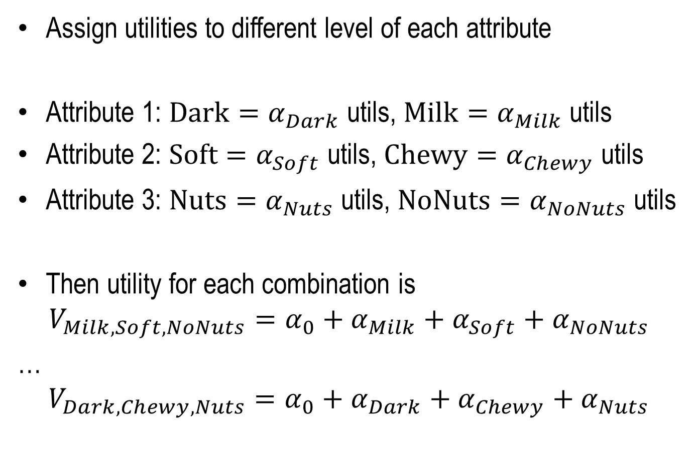
Example: Chocolate Study
Assign utilities to different level of each attribute
Attribute 1: $Dark{=α}_{Dark}$ utils, $Milk=α_{Milk}$ utils
Attribute 2: $Soft=α_{Soft}$ utils, $Chewy=α_{Chewy}$ utils
Attribute 3: $Nuts=α_{Nuts}$ utils, $NoNuts=α_{NoNuts}$ utils
Then utility for each combination is
$$V_{Milk, Soft,NoNuts}=α_{0}+α_{Milk}+α_{Soft}+α_{NoNuts}$$
…
$$V_{Dark, Chewy,Nuts}=α_{0}+α_{Dark}+α_{Chewy}+α_{Nuts}$$

Slide 10
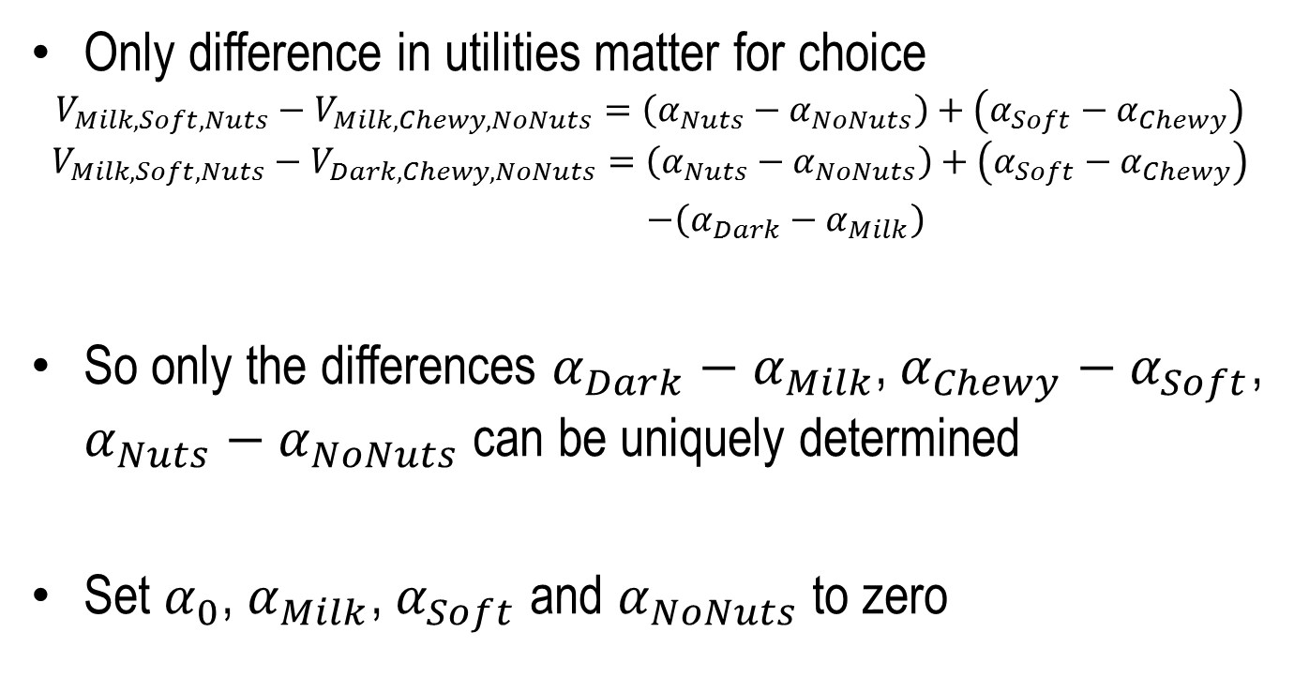
Example: Chocolate Study
Only difference in utilities matter for choice
$$V_{Milk, Soft,Nuts}−V_{Milk, Chewy,NoNuts}=\left(α_{Nuts}−α_{NoNuts}\right)+\left(α_{Soft}−α_{Chewy}\right)$$
$$V_{Milk, Soft,Nuts}−V_{Dark, Chewy,NoNuts}=\left(α_{Nuts}−α_{NoNuts}\right)+\left(α_{Soft}−α_{Chewy}\right)$$
$−\left(α_{Dark}−α_{Milk}\right)$
So only the differences $α_{Dark}−α_{Milk}$, $α_{Chewy}−α_{Soft}$, $α_{Nuts}−α_{NoNuts}$ can be uniquely determined
Set $α_{0}$, $α_{Milk}$, $α_{Soft}$ and $α_{NoNuts}$ to zero

Slide 11
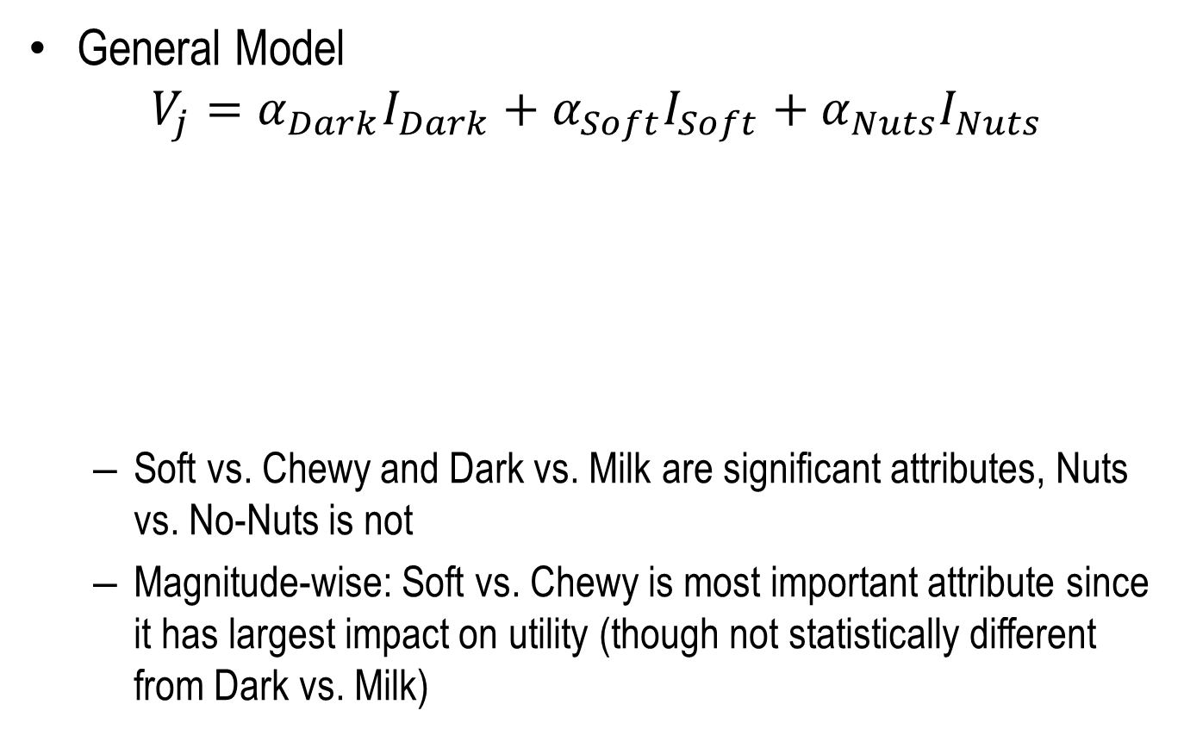
Example: Chocolate Study
General Model
$$V_{j}=α_{Dark}I_{Dark}+α_{Soft}I_{Soft}+α_{Nuts}I_{Nuts}$$
Soft vs. Chewy and Dark vs. Milk are significant attributes, Nuts vs. No-Nuts is not
Magnitude-wise: Soft vs. Chewy is most important attribute since it has largest impact on utility (though not statistically different from Dark vs. Milk)
Parameter |  | DF | Estimate | Standard Error | Wald Chi-Sq | Pr > ChiSq
Dark | 1 | 1 | 1.3863 | 0.7906 | 3.0749 | 0.0795
Soft | 1 | 1 | -2.1972 | 1.0541 | 4.3450 | 0.0371
Nuts | 1 | 1 | 0.8473 | 0.6901 | 1.5076 | 0.2195

Slide 12
Example: Chocolate Study
Dark, Chewy with Nuts is best alternative
But company can make tradeoffs based on cost of ingredients knowing how much consumers like these attributes
Participants had to choose from 8 alternatives at a time – can be difficult as number of alternatives increase
How much might consumers be willing to pay for an attribute?
Price can be one of the attributes

Slide 13
Conjoint Analysis Study
Estimate model of preference based on survey / field study to observe choices given various alternatives
Participants choose from a set of alternatives given the description of each alternative (and its attributes)
Set of alternatives shown is carefully selected to learn as much as possible about preference for different attributes
Full profile conjoint: Show each participant all possible alternatives based on the possible combinations of attributes
Not practical if number of combinations is high
Partial profile conjoint: Show each participant a subset of the possible alternatives, can be different across participants

Slide 14
Conjoint Analysis Study
One vs. Multiple choices for each participant:
Having one large set of alternatives can make it difficult for participants to compare between all alternatives and make a choice
One large set also limits how much we can learn about less preferred alternatives (since these alternatives are rarely chosen)
Instead, make several smaller sets of alternatives and have participants make multiple choices – one for each set of alternative
In partial profile conjoint, the sets of alternatives can vary between participants

Slide 15
Example: Car Design Study
Study Objective: Understand how consumers value the following attributes for a car
Seats: 6, 7 or 8
Engine: Gas, Hybrid or Electric
Cargo: 2ft or 3ft
Price: 30K, 35K or 40K USD
Study design
200 participants
Each participant chose from 3 combinations at a time, 15 times
3 price points: 30 K, 35K, 40 K
Different participants saw different combinations

Slide 16
Example: Car Design Study
Number of Times Each Combination was Used
 |  | eng
 |  | Elec |  |  | gas |  |  | hyb
 |  | price |  |  | price |  |  | price
seat | cargo | 30 | 35 | 40 | 30 | 35 | 40 | 30 | 35 | 40
6 | 2ft | 167 | 167 | 172 | 171 | 167 | 161 | 164 | 170 | 170
 | 3ft | 179 | 166 | 171 | 165 | 166 | 168 | 165 | 172 | 163
7 | 2ft | 167 | 166 | 167 | 172 | 165 | 172 | 157 | 162 | 167
 | 3ft | 173 | 154 | 172 | 165 | 161 | 173 | 164 | 167 | 169
8 | 2ft | 170 | 168 | 167 | 166 | 170 | 160 | 163 | 163 | 170
 | 3ft | 156 | 169 | 159 | 168 | 177 | 158 | 166 | 167 | 166

Slide 17
Example: Car Design Study
resp_id | ques | seat | cargo | eng | price | choice
1 | 1 | 6 | 2ft | gas | 35 | 0
1 | 1 | 8 | 3ft | hyb | 30 | 0
1 | 1 | 6 | 3ft | gas | 30 | 1
1 | 2 | 6 | 2ft | gas | 30 | 0
1 | 2 | 7 | 3ft | gas | 35 | 1
1 | 2 | 6 | 2ft | elec | 35 | 0
.
.
.
.
.
.
.
.
.
2 | 1 | 6 | 2ft | elec | 40 | 1
2 | 1 | 7 | 3ft | gas | 40 | 0
2 | 1 | 6 | 2ft | elec | 30 | 0
2 | 2 | 6 | 2ft | gas | 30 | 1
2 | 2 | 6 | 3ft | hyb | 40 | 0
2 | 2 | 7 | 2ft | gas | 30 | 0

Slide 18

Example: Car Design Study
Reference attribute levels: 6 seats, 2 ft cargo, gas engine
General Utility:
$$V_{j}=α_{7st}I_{7st}+α_{8st}I_{8st}+α_{3ft}I_{3ft}$$
$+α_{hyb}I_{hyb}+α_{ele}I_{ele}+βPrice_{j}$
Parameter |  | DF | Estimate | Standard Error | Wald Chi-Sq | Pr > ChiSq
seat | 7 | 1 | -0.5345 | 0.0624 | 73.4956 | <.0001
seat | 8 | 1 | -0.3061 | 0.0611 | 25.0844 | <.0001
cargo | 3ft | 1 | 0.4767 | 0.0509 | 87.8359 | <.0001
eng | elec | 1 | -1.5291 | 0.0674 | 514.7410 | <.0001
eng | hyb | 1 | -0.8107 | 0.0601 | 181.8833 | <.0001
price |  | 1 | -0.1733 | 0.00694 | 623.6288 | <.0001

Slide 19
Example: Car Design Study
Engine is the most important attribute: Largest impact on utility
Gas engine, 6 seater and extra cargo space preferred
Willingness to pay for extra cargo space
What is the price increase that will offset the increase in utility from extra cargo space?
Utility from extra cargo space = 0.4767
Price increase that will offset this utility = 0.4767 / 0.1733 = 2.75 K
However, there is usually competition in the market. How can we incorporate competition?
What will be market share? Will total market size increase?

Slide 20
Conjoint Analysis Study
Conjoint approach can also be applied to real world data
Represent each alternative as a combination of attributes
Examples:
Sodas are a combination of brand name, type and nutritional (calorific) attributes
Smartphones are a combination of brand name, physical and technical attributes (e.g., screen size, camera resolution)
However, there may not be enough variation in some attributes in real world data
If there is not enough variation in an attribute, then its impact on consumer utility and choice cannot be estimated

Slide 21
Part II: Market Share and Market Size Studies

Slide 22
Basic Idea
Changing price or introducing new features can cause consumers to switch brands AND also attract new consumers who were not buying any of the considered brands
E.g., Samsung lowers price of 4K HDTV
Brand switching: Some consumers who would have bought a new LG TV will now instead buy Samsung
Category Expansion: Some consumers who would not have bought a TV at all will now buy Samsung
To predict complete effect of a marketing action, we need to predict both brand switching and category expansion
Consider both whether consumers buy, and what they buy

Slide 23
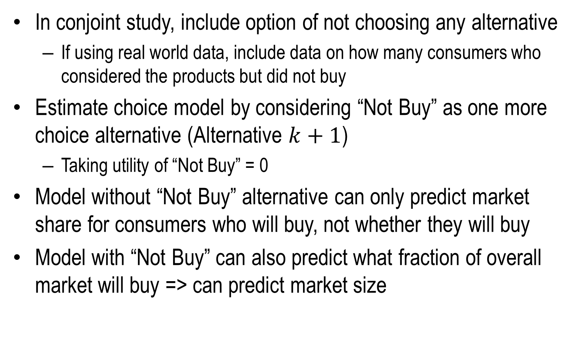
Basic Idea
In conjoint study, include option of not choosing any alternative
If using real world data, include data on how many consumers who considered the products but did not buy
Estimate choice model by considering “Not Buy” as one more choice alternative (Alternative $k+1$)
Taking utility of “Not Buy” = 0
Model without “Not Buy” alternative can only predict market share for consumers who will buy, not whether they will buy
Model with “Not Buy” can also predict what fraction of overall market will buy => can predict market size

Slide 24
Example: Consoles Pricing Study
Study Objective: Determine how price of videogame consoles affects sales and market share
3 Consoles: XBox, Playstation, Wii
Study Design
For different combinations of prices for 3 consoles, how many consumers bought a console, and which console did they buy (sample size: 100 for each price combination)
Note: Why not model total sales for a console as a function of the prices?
Cannot predict how sales of all three consoles will change when price of one console changes
Fewer observations once choice data is aggregated as sales

Slide 25
Example: Consoles Pricing Study
# of people who chose each console for each combination
# of people who chose not to buy
XBox_Price | PS_ Price | Wii_ Price | XBox_ Chosen | PS_ Chosen | Wii_ Chosen | None_ Chosen
221 | 267 | 275 | 28 | 11 | 14 | 47
193 | 295 | 275 | 38 | 1 | 14 | 47
278 | 294 | 176 | 10 | 2 | 43 | 45
288 | 191 | 250 | 2 | 44 | 10 | 44
162 | 224 | 221 | 30 | 16 | 17 | 37
172 | 249 | 157 | 23 | 15 | 24 | 38
167 | 251 | 169 | 24 | 12 | 25 | 39
213 | 255 | 158 | 21 | 25 | 9 | 45

Slide 26
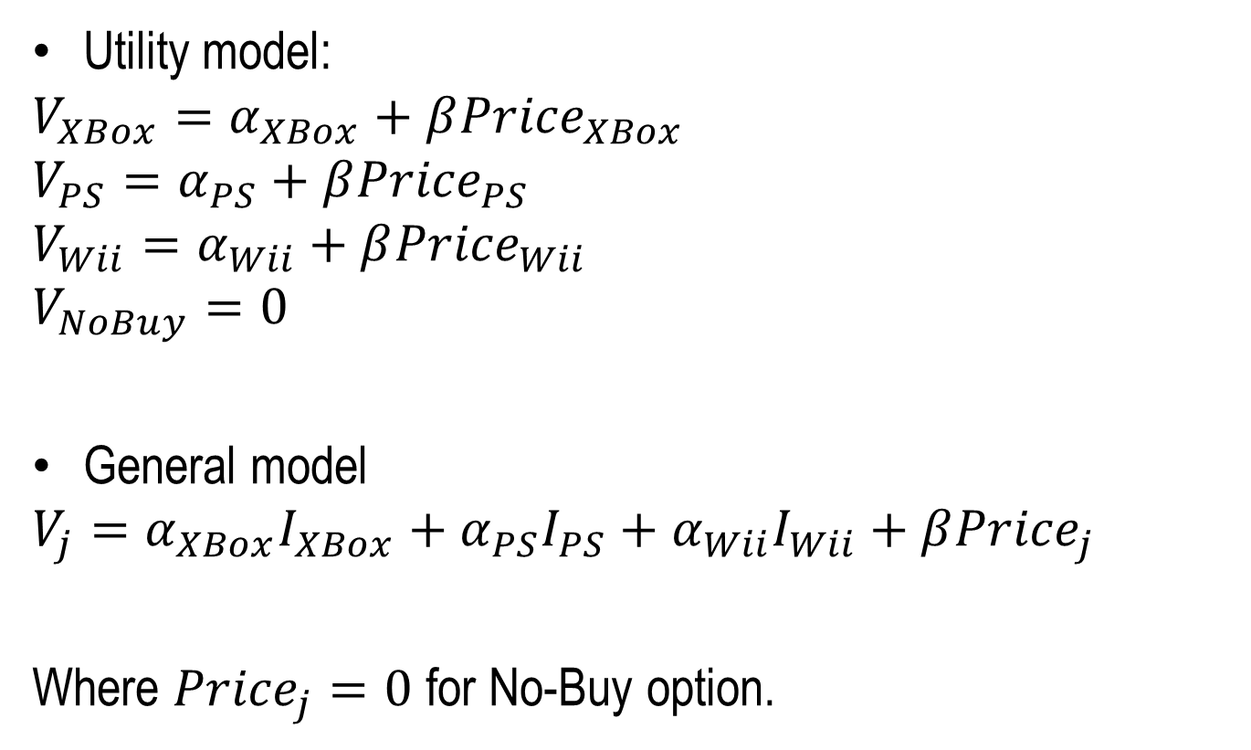
Example: Consoles Pricing Study
Utility model:
$$V_{XBox}=α_{XBox}+β{Price}_{XBox}$$
$$V_{PS}=α_{PS}+β{Price}_{PS}$$
$$V_{Wii}=α_{Wii}+β{Price}_{Wii}$$
$$V_{NoBuy}=0$$
General model
$$V_{j}=α_{XBox}I_{XBox}+α_{PS}I_{PS}+α_{Wii}I_{Wii}+β{Price}_{j}$$
Where ${Price}_{j}=0$ for No-Buy option.

Slide 27
Example: Consoles Pricing Study
# of people who chose each console for each combination
# of people who chose not to buy
XBox_Price | PS_ Price | Wii_ Price | XBox_ Chosen | PS_ Chosen | Wii_ Chosen | None_ Chosen
221 | 267 | 275 | 28 | 11 | 14 | 47
193 | 295 | 275 | 38 | 1 | 14 | 47
278 | 294 | 176 | 10 | 2 | 43 | 45
288 | 191 | 250 | 2 | 44 | 10 | 44
162 | 224 | 221 | 30 | 16 | 17 | 37
172 | 249 | 157 | 23 | 15 | 24 | 38
167 | 251 | 169 | 24 | 12 | 25 | 39
213 | 255 | 158 | 21 | 25 | 9 | 45

Slide 28
Example: Consoles Pricing Study
Transform count data format to choice data format, with price as alternative characteristic
p_id | Chosen | Price | Brand
1 | 1 | 221 | XBox
1 | 0 | 267 | PS
1 | 0 | 275 | Wii
1 | 0 | 0 | None
2 | 1 | 221 | XBox
2 | 0 | 267 | PS
2 | 0 | 275 | Wii
2 | 0 | 0 | None
⁞ | ⁞ | ⁞ | ⁞
29 | 0 | 221 | XBox
29 | 1 | 267 | PS
29 | 0 | 275 | Wii
29 | 0 | 0 | None
Choice Occasion 1
Choice Occasion 2
Choice Occasion 29

Slide 29

Example: Consoles Pricing Study
$$V_{j}=1.9I_{XBox}+2.1I_{PS}+1.75I_{Wii}−0.0125{Price}_{j}$$
Parameter |  | DF | Estimate | Standard Error | Wald Chi-Sq | Pr > ChiSq
Brand | PS | 1 | 2.1084 | 0.3407 | 38.3027 | <.0001
Brand | Wii | 1 | 1.7456 | 0.2764 | 39.8868 | <.0001
Brand | XBox | 1 | 1.9032 | 0.2805 | 46.0285 | <.0001
Price |  | 1 | -0.0125 | 0.00134 | 88.1167 | <.0001

Slide 30
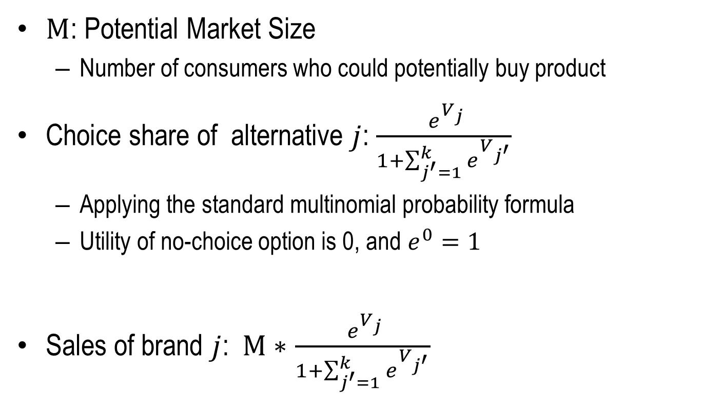
Example: Consoles Pricing Study
$M$: Potential Market Size
Number of consumers who could potentially buy product
Choice share of alternative $j$: $\frac{ e^{V_{j}}}{1+\sum_{j^{′}=1}^{k}{e^{V_{j^{′}}}}}$
Applying the standard multinomial probability formula
Utility of no-choice option is 0, and $e^{0}=1$
Sales of brand $j$: $M∗$ $\frac{ e^{V_{j}}}{1+\sum_{j^{′}=1}^{k}{e^{V_{j^{′}}}}}$

Slide 31
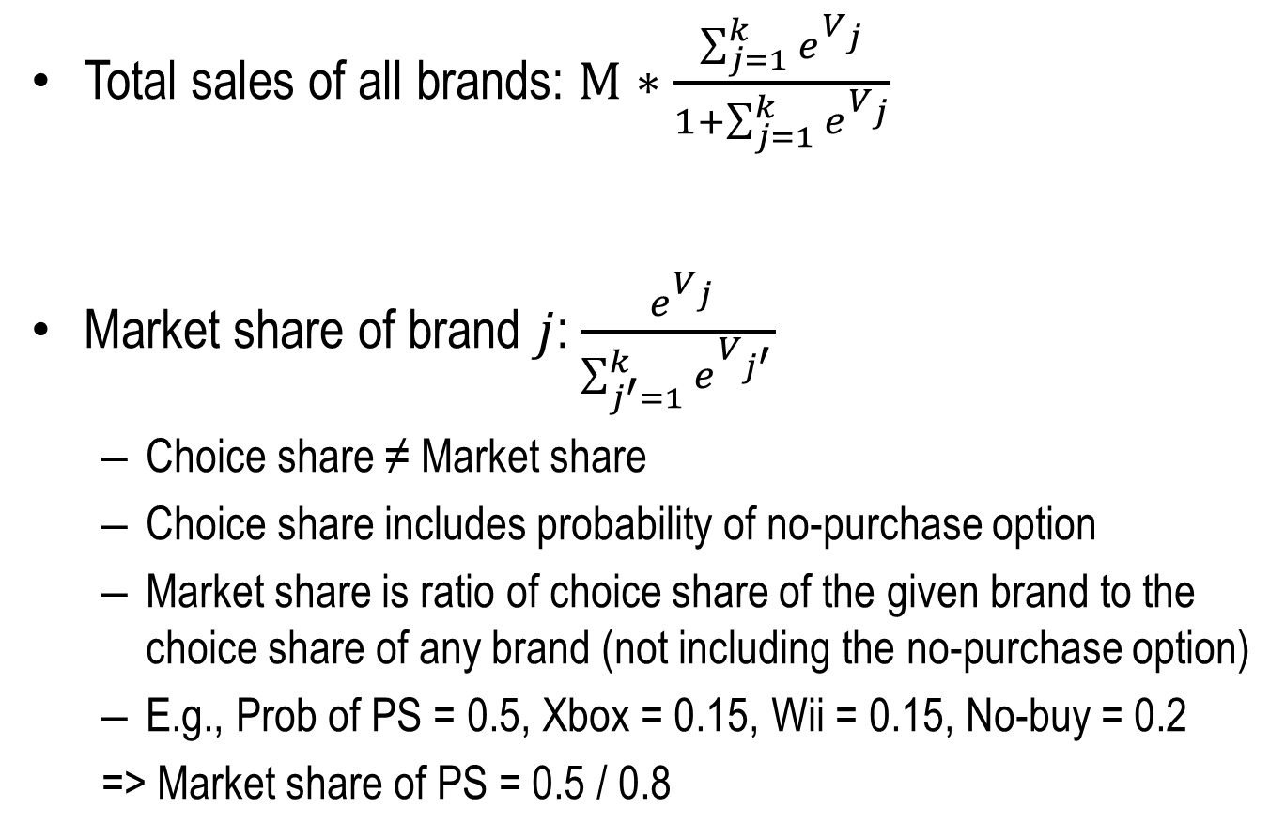
Example: Consoles Pricing Study
Total sales of all brands: $M∗\frac{\sum_{j=1}^{k}{e^{V_{j}}}}{1+\sum_{j=1}^{k}{e^{V_{j}}}}$
Market share of brand $j$: $\frac{ e^{V_{j}}}{\sum_{j^{′}=1}^{k}{e^{V_{j^{′}}}}}$
Choice share ≠ Market share
Choice share includes probability of no-purchase option
Market share is ratio of choice share of the given brand to the choice share of any brand (not including the no-purchase option)
E.g., Prob of PS = 0.5, Xbox = 0.15, Wii = 0.15, No-buy = 0.2
=> Market share of PS = 0.5 / 0.8

Slide 32
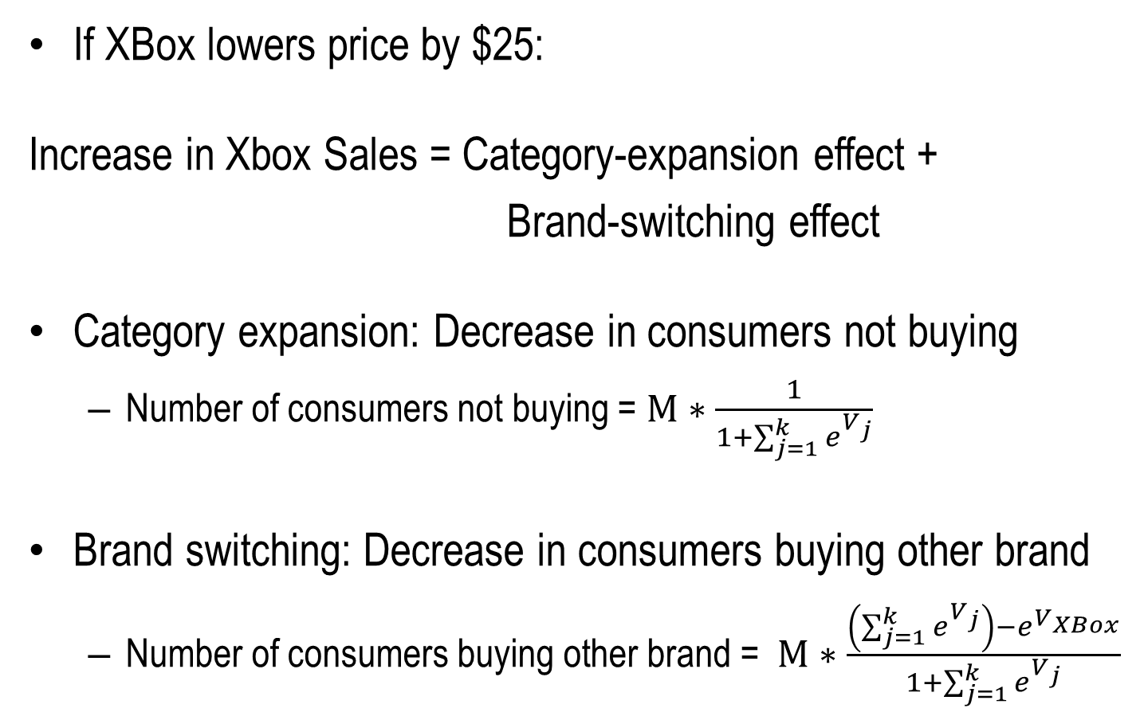
Example: Consoles Pricing Study
If XBox lowers price by $25:
Increase in Xbox Sales = Category-expansion effect +
Brand-switching effect
Category expansion: Decrease in consumers not buying
Number of consumers not buying = $M∗\frac{1}{1+\sum_{j=1}^{k}{e^{V_{j}}}}$
Brand switching: Decrease in consumers buying other brand
Number of consumers buying other brand = $M∗\frac{\left(\sum_{j=1}^{k}{e^{V_{j}}}\right)−e^{V_{XBox}}}{1+\sum_{j=1}^{k}{e^{V_{j}}}}$

